Slide 1

HASIBUL ISLAM

Slide 2

NEw YoRk CiTy Apartment Rent Price Analysis

Slide 3
GOAL
Where to rent apartment in NYC by asking the customer to find better price?

Slide 4
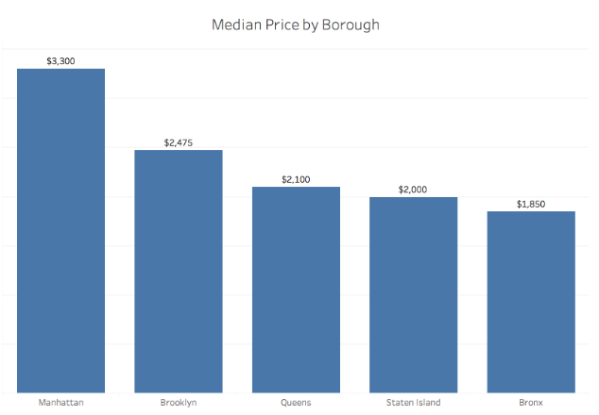
What is it like to live NYC?
Rent Monthly ($price)
Brooklyn
Manhattan
Queens
Bronx
Staten Island

Slide 5
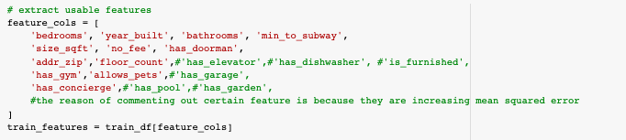
Data Collection
Using data from StreetEasy and Zillow
Number of bedrooms
Number of bathroom
Size in sqft
Price
Zip-Code

Slide 6
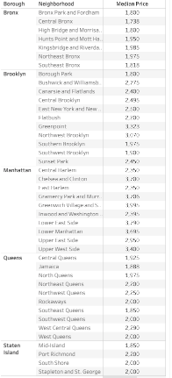
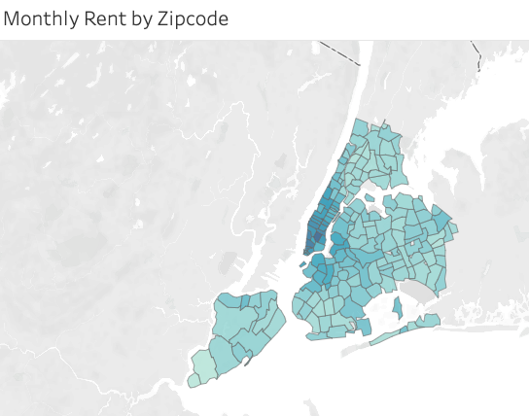
Data Collection
Using data from StreetEasy and Zillow
Number of bedrooms
Number of bathroom
Size in sqft
Price
Zip-Code
Dataset will show of rent.csv file
df = pd.read_csv('rent.csv')
df.head()

Slide 7
DataSet Applying for Machine Learning Algorithms on this project
Will show the accuracy of each algorithms
Linear Regression
Logistic Regression
SVM
Decision tree
Random Forests

Slide 8
DataSet
Linear Regression:
performed poorly data and not really correlated with each other
SVR performed better (22%) than others (6%)
accuracy( got is very low) and cannot use Linear Regression (22% highest accuracy).

Slide 9
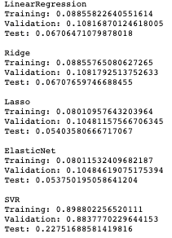
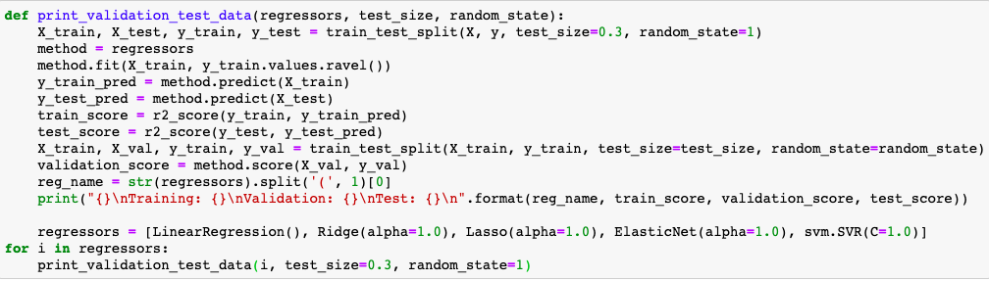
Linear Regression
Testing to see first
Notes:
LinearRegression
Training: 0.08855822640551614
Validation: 0.10816870124618005
Test: 0.06706471079878018

Slide 10
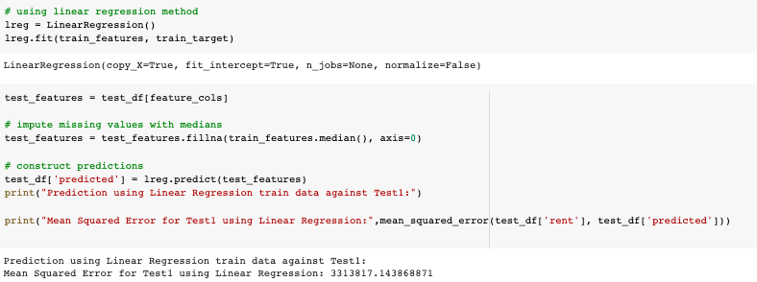
Linear Regression
Final Test Result
Notes:
LinearRegression
Training: 0.08855822640551614
Validation: 0.10816870124618005
Test: 0.06706471079878018

Slide 11
DataSet
Logistic Regression
To have better results for 5-borough in DataSet
Without scaling using algorithm gives correct prediction 67% of the time.
Better use StandardScaler()

Slide 12
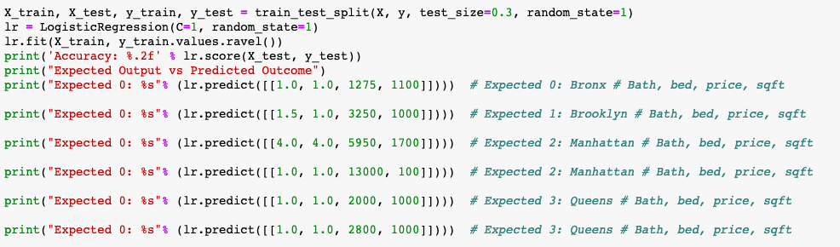
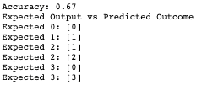
Logistic Regression
Testing to see first
Notes:
Accuracy: 0.67
Expected Output vs Predicted Outcome
Expected 0: [0]
Expected 1: [1]
Expected 2: [1]
Expected 2: [2]
Expected 3: [0]
Expected 3: [3]

Slide 13
DataSet
SVM
Used three kernels: linear (80%), RBF (79%), and Sigmoid (20%)
Use the correct kernel and adjust the parameters (gamma).
Better Result of the DataSet

Slide 14
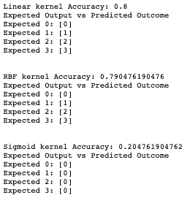
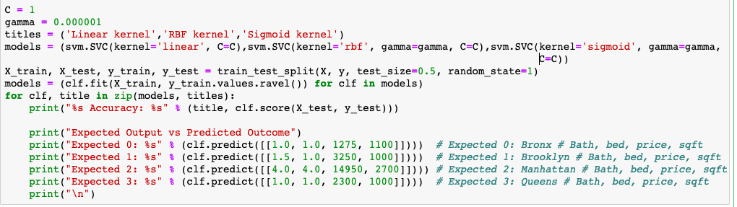
SVM
Testing to see first
Notes:
Linear kernel Accuracy: 0.8
Expected Output vs Predicted Outcome
Expected 0: [0]
Expected 1: [1]
Expected 2: [2]
Expected 3: [3]

Slide 15
DataSet
Decision tree
Score of 74% for better than i should get
Data completely (25% error)

Slide 16
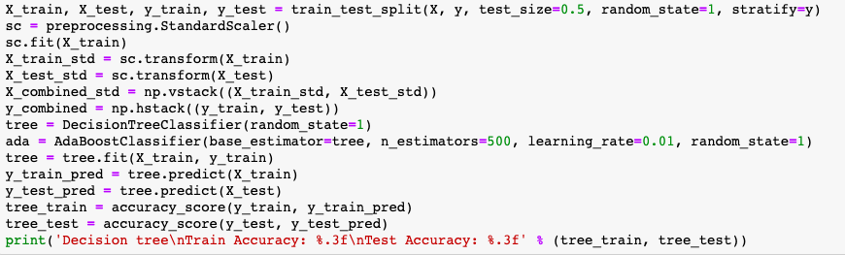

Decision Tree
Testing to see first
Notes:
Decision tree
Train Accuracy: 1.000
Test Accuracy: 0.733

Slide 17
DataSet
Random Forests
Very similar to decision trees.
Data not overfitting
Show similar score of 74%

Slide 18
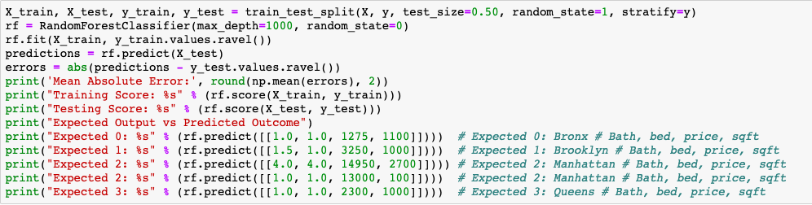

Random Forests
Testing to see first
Notes:
Mean Absolute Error: 0.52
Training Score: 0.985714285714
Testing Score: 0.747619047619
Expected Output vs Predicted Outcome
Expected 0: [0]
Expected 1: [1]
Expected 2: [2]
Expected 2: [1]
Expected 3: [0]

Slide 19
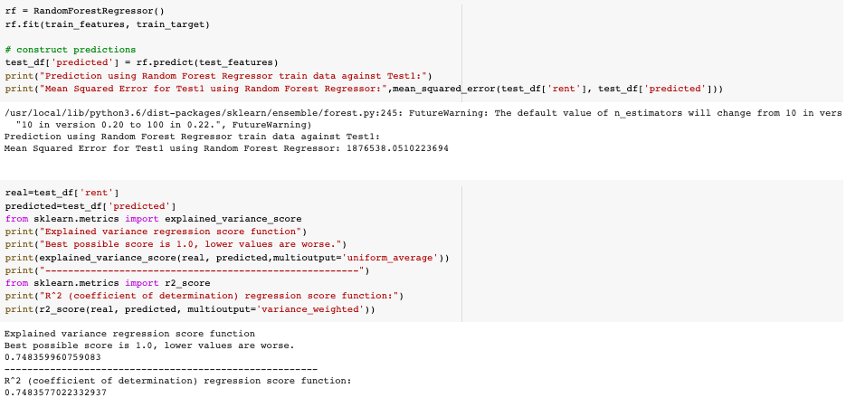
Random Forests
Testing to see first
Final Test Result
Notes:
Mean Absolute Error: 0.52
Training Score: 0.985714285714
Testing Score: 0.747619047619
Expected Output vs Predicted Outcome
Expected 0: [0]
Expected 1: [1]
Expected 2: [2]
Expected 2: [1]
Expected 3: [0]

Slide 20
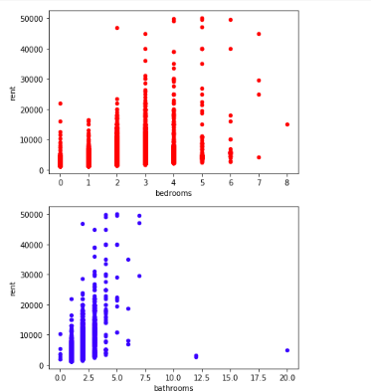
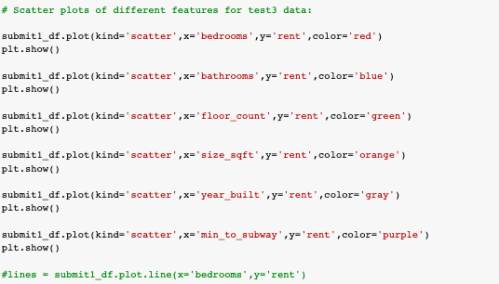
FINAL RESULT
FINAL RESULT OF THE CODE
Notes:
Mean Absolute Error: 0.52
Training Score: 0.985714285714
Testing Score: 0.747619047619
Expected Output vs Predicted Outcome
Expected 0: [0]
Expected 1: [1]
Expected 2: [2]
Expected 2: [1]
Expected 3: [0]

Slide 21
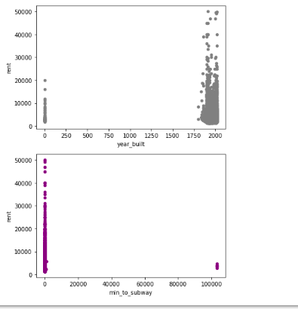
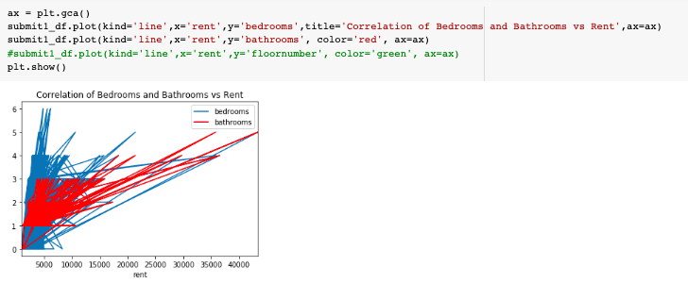
FINAL RESULT
FINAL RESULT OF THE CODE
Notes:
Mean Absolute Error: 0.52
Training Score: 0.985714285714
Testing Score: 0.747619047619
Expected Output vs Predicted Outcome
Expected 0: [0]
Expected 1: [1]
Expected 2: [2]
Expected 2: [1]
Expected 3: [0]

Slide 22


